Slide 1
Functions in C

Slide 2
Introduction
A function is a self-contained subprogram that is meant to do some specific, well-defined task.
A C program consists of one or more functions.
If a program has only one function then it must be the main( ) function.

Slide 3
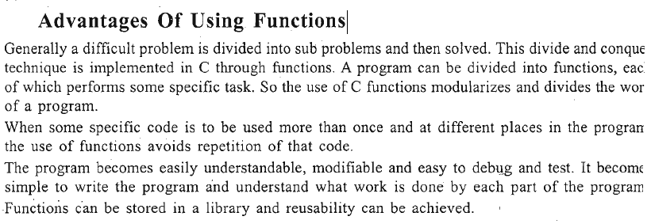
C programs have two types' of functions- 1. Library functions ... 2. User-defined functions

Slide 4
Library Functions
C has the facility to provide library functions for performing some operations. These functions are present in the C library and they are predefined.
For example sqrt( ) is a mathematical library function which is used for finding out the square root of any number. The functions scanf( ) and printf( ) are input output library functions.
To use a library function we have to include corresponding header file using the preprocessor directive #include.
For example to use input output functions like printf( ), scanf( ) we have to include stdio, for mathematical library functions we have to include math.h

Slide 5
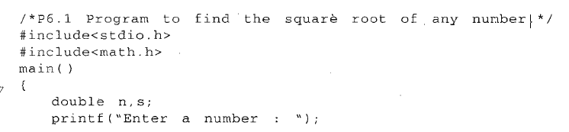
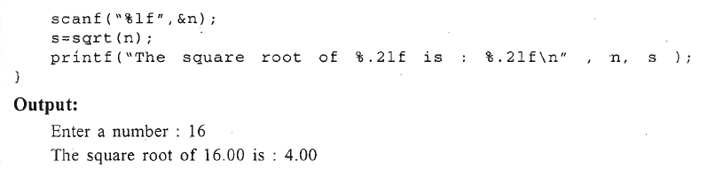

Slide 6
User Defined Functions
Users can create their own functions for performing any specific task of the program.
These types of functions are called user-defined functions. To create and use these functions, we should know about these three things :
1. Function definition .
2. Function declaration
3. Function call

Slide 7
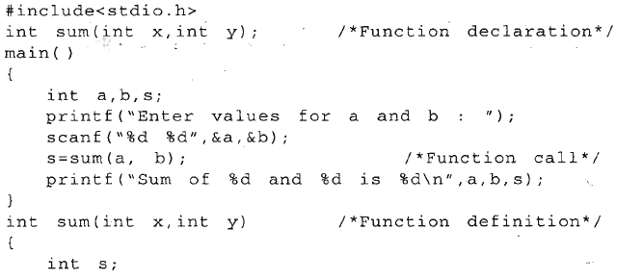
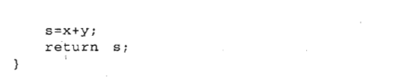
Program to find the sum of two numbers

Slide 8
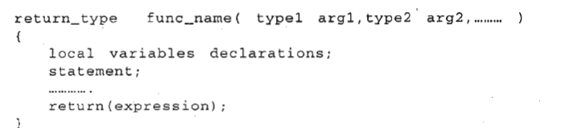
Function Definition
The function definition consists ·of the whole description and code of a function.
It tells what the function is doing and what are its inputs and outputs. A function definition consists of two parts - a function header and a function body. The general syntax of a function definition is

Slide 9
The first line in the function definition is known as the function header.
The return_type denotes the type of the value that will be returned by the function. The return_type is optional and if omitted, it is assumed to be int by default.
A function can return. either one no value.
If a function does not return any value then void should be written in place of return_type

Slide 10
func_name specifies the name of the function and it can be any valid C identifier.
After function name the argument declaration are given in parentheses, which mention the type and name of the arguments
These are known as formal arguments and used to accept values. A function can take any number of arguments or even no argument at all.
If there are no arguments then either the parentheses can be left empty or void can be written inside the parentheses.

Slide 11
The body of function is a compound statement (or a block), which consists of declarations of variables and C statements followed by an optional return statement.
The variables declared inside the functions are known as local variables, since they are local to that function only, i.e. they have existence only in the function in which they are declared, they can not be used anywhere else in the program.
There can be any number of valid C statements inside a function body. The return statement is optional.
It may be absent if the function does not return any value.

Slide 12
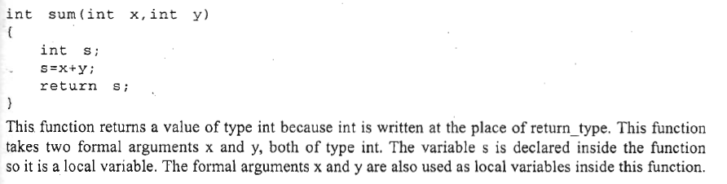
The function definition can be placed anywhere in the program. But generally all definitions are placed after the main( ) function.
Note that a function definition cannot be placed inside another function definition.
Function definitions can also be placed in different files.

Slide 13
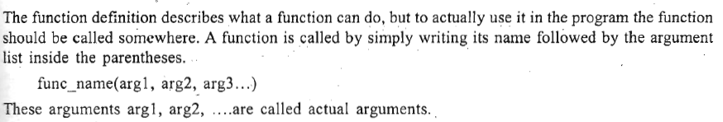
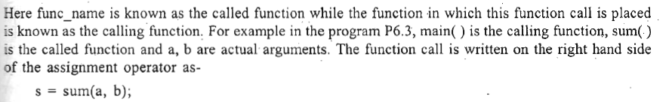
Function Call
Even if there are no actual arguments, the function call should have the empty parentheses

Slide 14
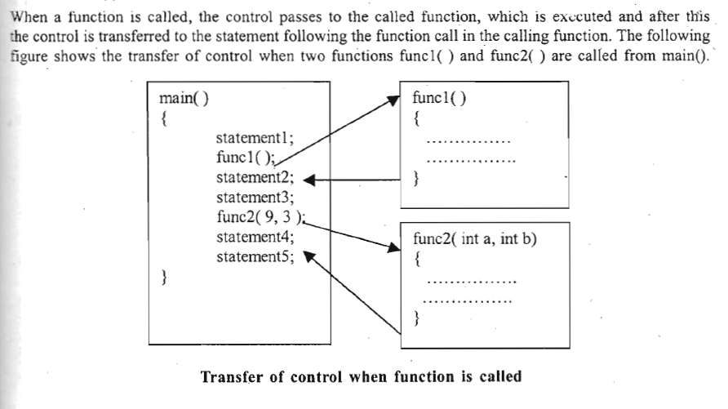

Slide 15
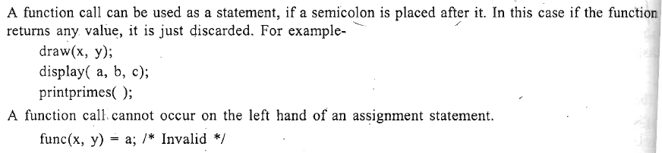
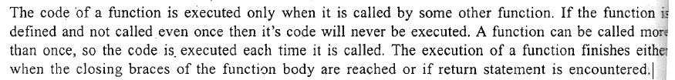

Slide 16
Function Declaration
The calling function needs information about the called function. If definition of the called function placed before the calling function, then declaration is not needed.
For example if in program~ P6.3, the definition of sum( ) is written before main( ), then declaration is not needed.

Slide 17
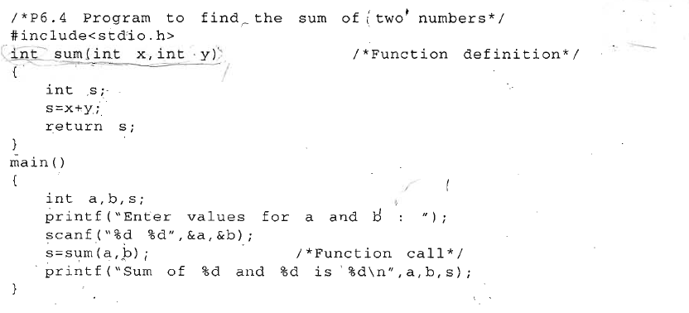

Slide 18
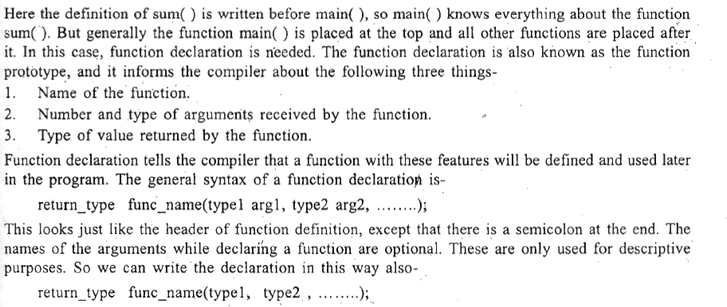

Slide 19
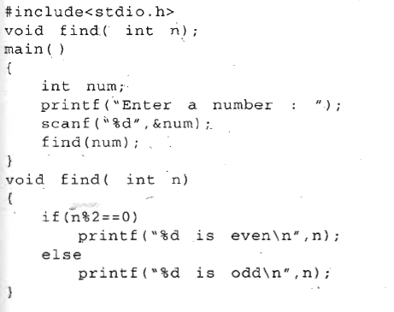
Program that finds whether a number is even or odd

Slide 20
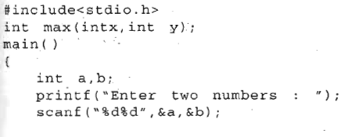
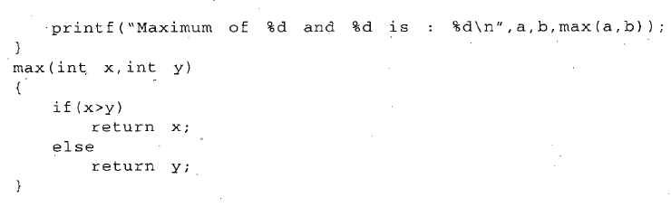
Program that finds the larger of two numbers

Slide 21
return statement
The return statement is used in a function to return a value to the calling function.
It may also be used for immediate exit from the called function to the calling function without returning a value.
This statement can appear anywhere inside the body of the function. There are two ways in which it can be used- .
return;
return ( expression );
Here return is a keyword. The first form of return statement is used to terminate the function without returning any value. In this case only return keyword is written.
The value returned by the return statement may be any constant, variable, expression or even any other function call(which returns a value).

Slide 22
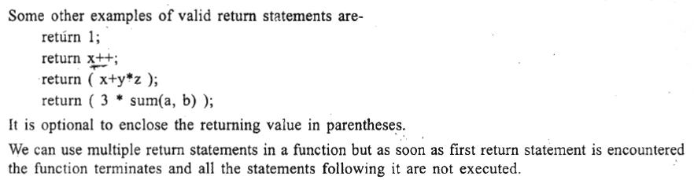

Slide 23
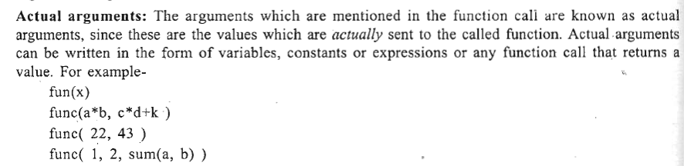
Function Arguments
The calling function sends some values to the called function for communication; these values are called arguments or parameters

Slide 24
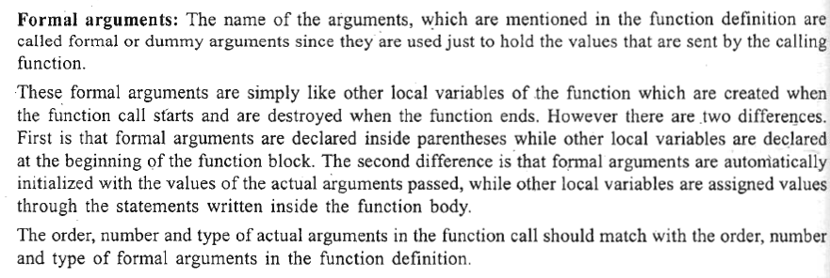

Slide 25
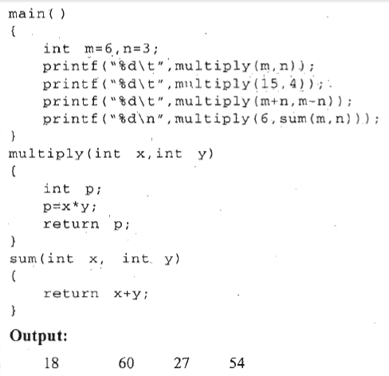

Slide 26
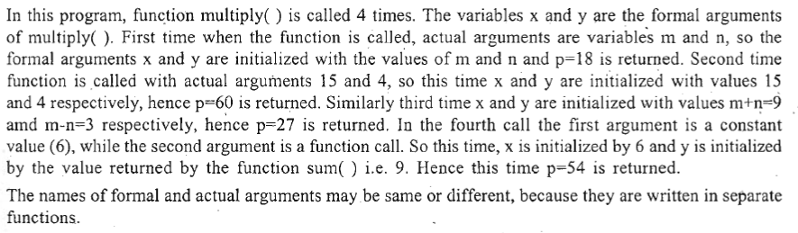

Slide 27
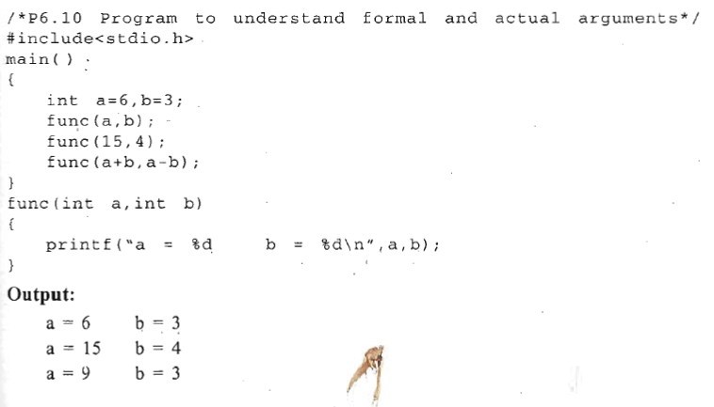

Slide 28
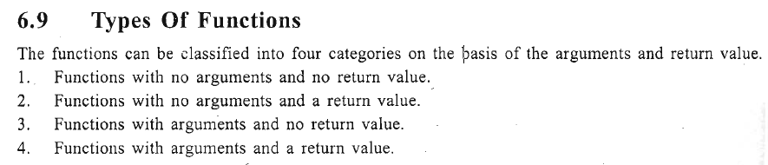

Slide 29
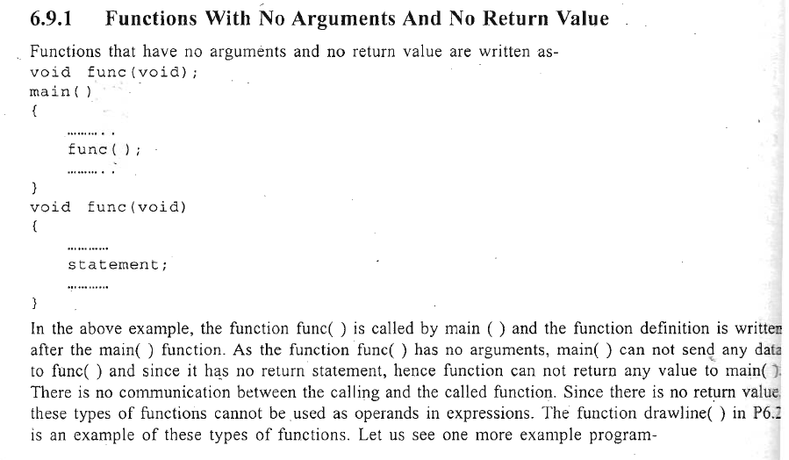

Slide 30
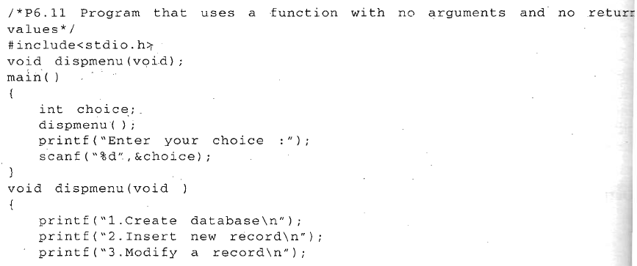
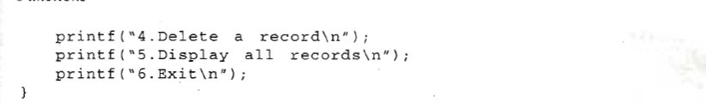

Slide 31
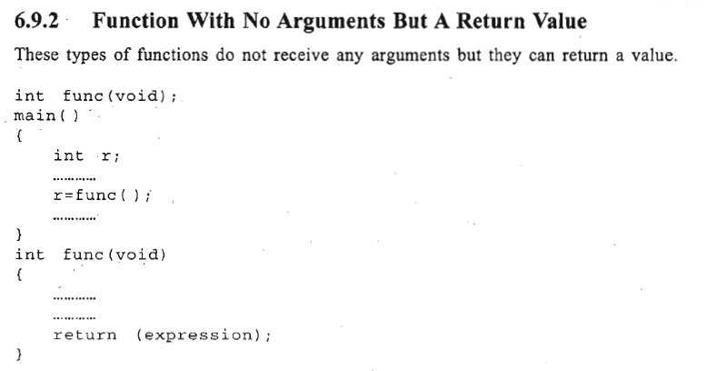

Slide 32
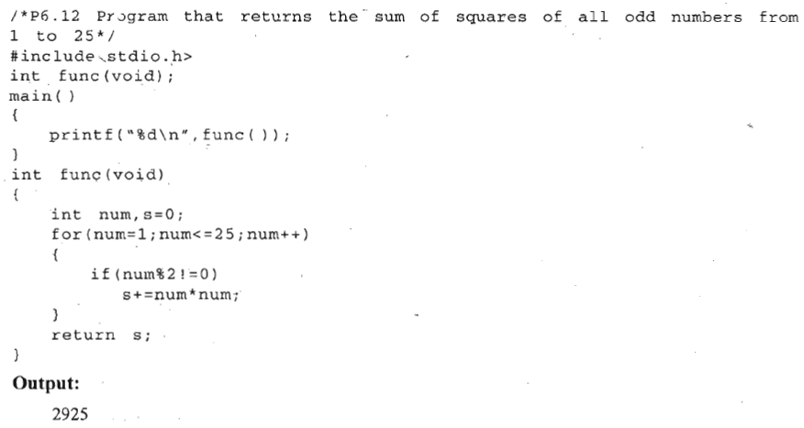

Slide 33
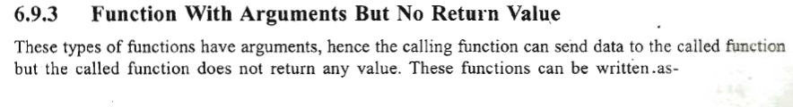
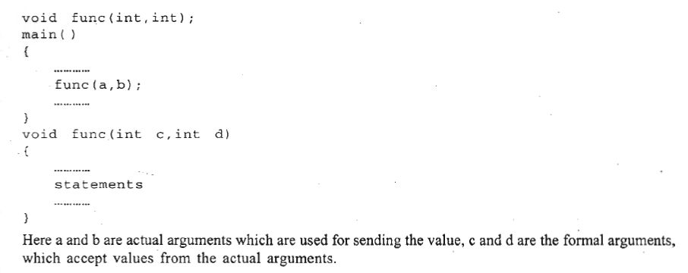

Slide 34
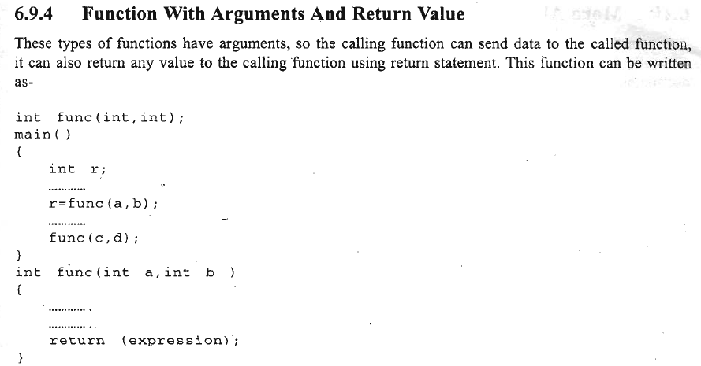


Slide 35
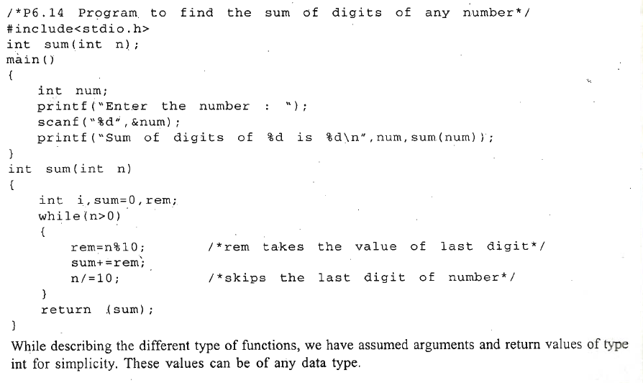

Slide 36
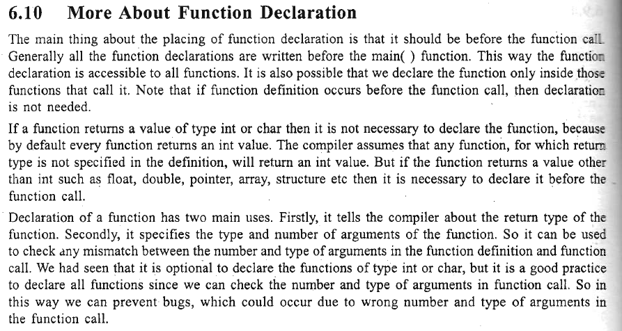

Slide 37
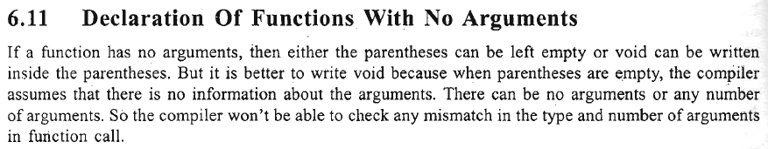

Slide 38
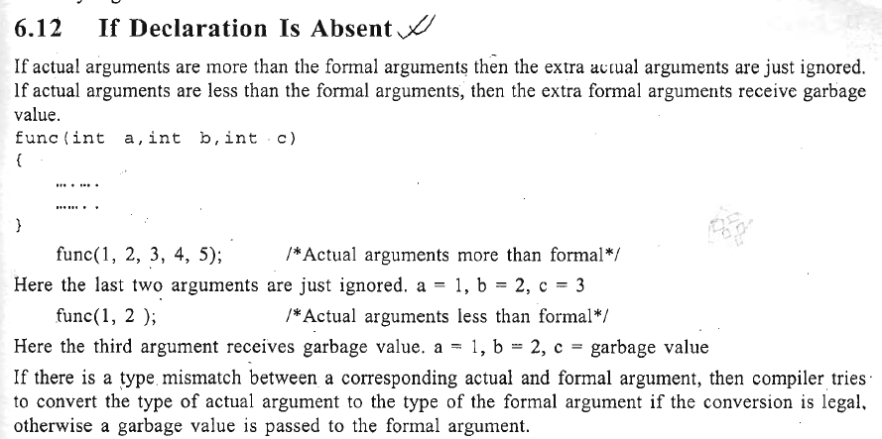

Slide 39
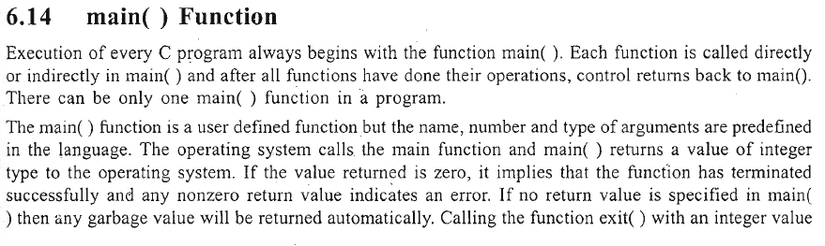
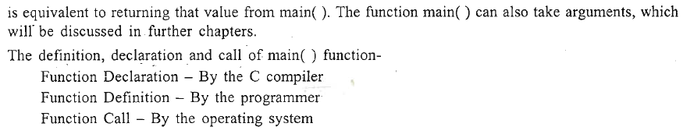

Slide 40
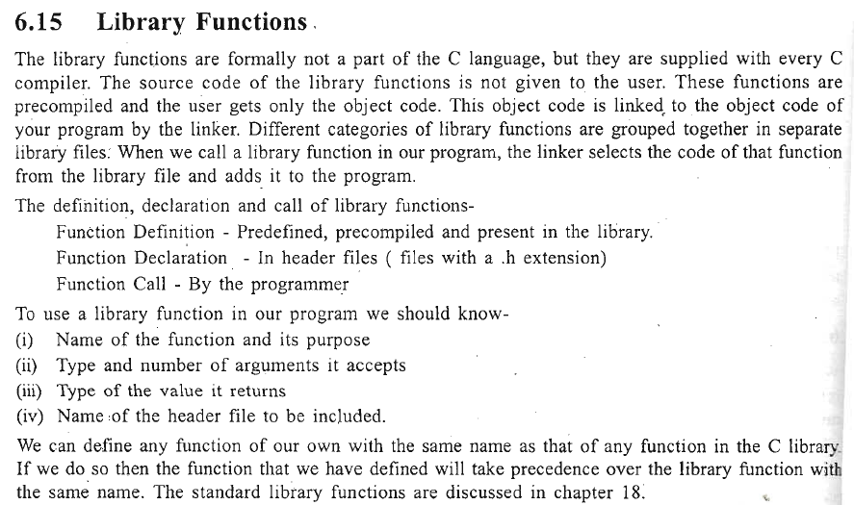

Slide 41
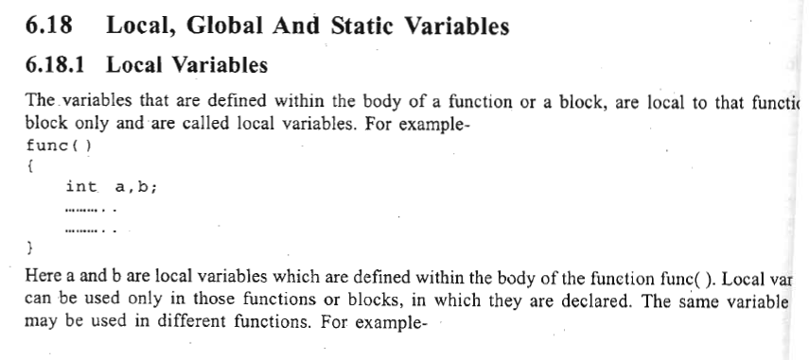
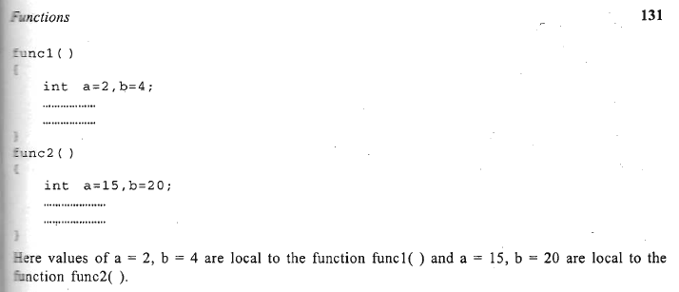

Slide 42
Global Variables
The variables that are defined outside any function are called global variables:
All functions in the program can access and modify global variables. It is useful to declare a variable global if it is to be used by many functions in the program.
Global variables are automatically initialized to 0 at the time of declaration.

Slide 43
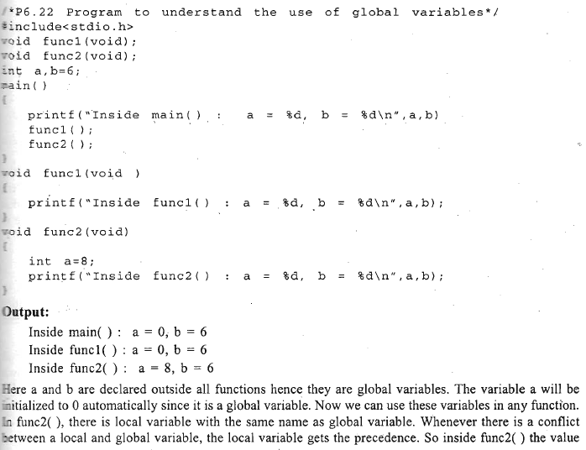

Slide 44
Recursion
Recursion is a powerful technique of writing a complicated algorithm in an easy way.
According to this technique a problem is defined in terms of itself.
The problem is solved by dividing it into small problems, which are similar in nature to the original problem. These smaller problems are solved their solutions are applied to get the final solution of our original problem.
Recursion is the process of repeating items in a self-similar way. In programming languages, if a program allows you to call a function inside the same function, then it is called a recursive call of the function.

Slide 45
To implement recursion technique in programming, a function should be capable of calling itself
This facility is available in C. The function that calls itself(inside function body}again and again is called a recursive function.
In recursion, the calling function and the called function are same.
The C programming language supports recursion, i.e., a function to call itself. But while using recursion, programmers need to be careful to define an exit condition from the function, otherwise it will go into an infinite loop.
Recursive functions are very useful to solve many mathematical problems, such as calculating the factorial of a number, generating Fibonacci series, etc.

Slide 46

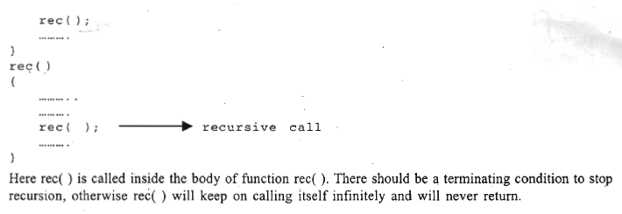
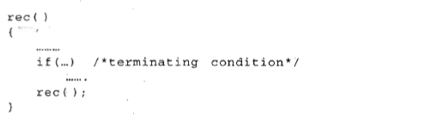

Slide 47
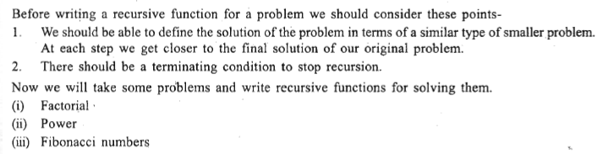

Slide 48
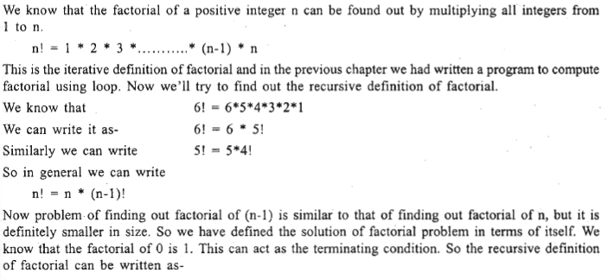

Slide 49
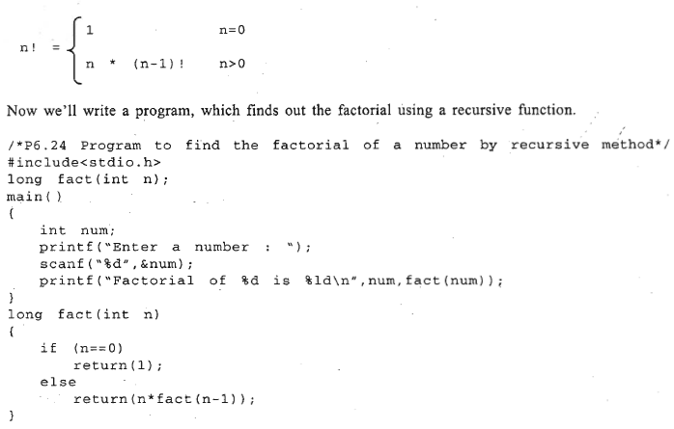
n =4
return(4*fact(3));
return(3*fact(2));
return(2*fact(1));
return(1*fact(0));
24

Slide 50
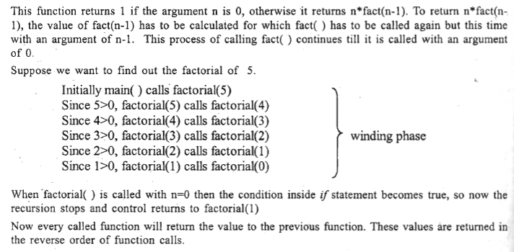
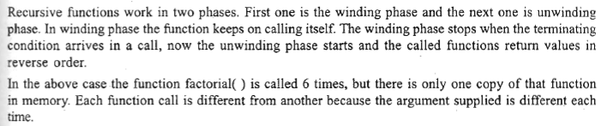

Slide 51
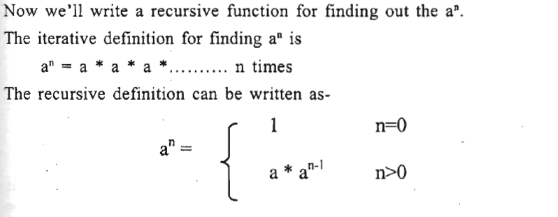

Slide 52

A=3,n=2
3*power(3,1);
3*power(3,0)
3*1
=9

Slide 53

1,1,2,3,5,8,13,21,34

Slide 54


Slide 55


Slide 56

Advantages and Disadvantages of Recursion
Recursion makes program elegant. However, if performance is vital, use loops instead as recursion is usually much slower.
That being said, recursion is an important concept. It is frequently used in data structure and algorithms.

Slide 57

Sum of Natural Numbers Using Recursion

Slide 58


Slide 59


